Slide 1
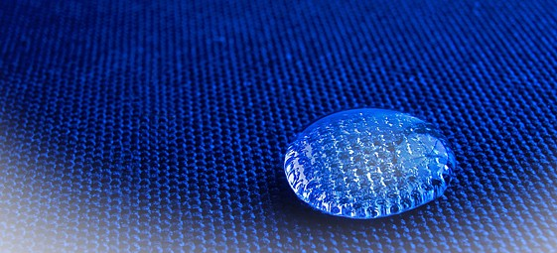
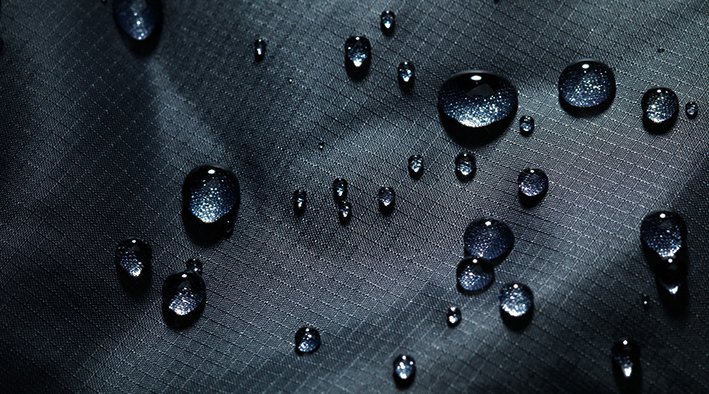
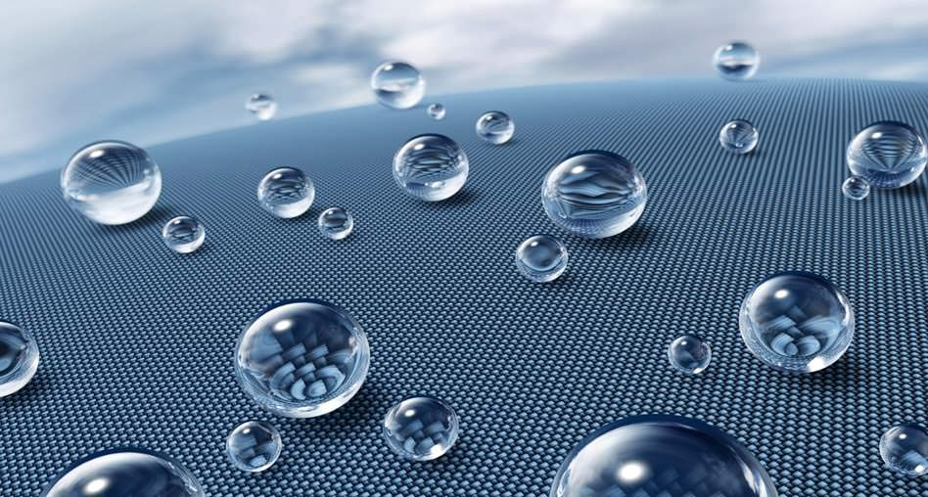
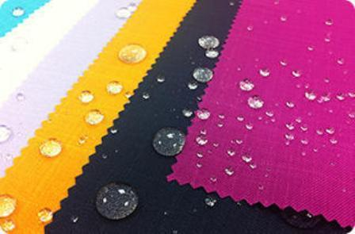
NANO TECHNOLOGY IN CLOTHES

Slide 2
Introduction
Nanotechnology in clothes has provided advantage in clothing industry in terms of waterproof, microbiological, UV-blocking.
This new trending technology just started to set up its brand in current industry to make clothes more reliable and long-lasting.
Nanotechnology is providing clothing manufacturers with whole new dimensions of design to work with. From lightweight specialist high-endurance clothing to suits which don't get wet in the rain, nano-enhanced clothing will become a more and more visible part of our lives in the future.
Nanoparticles are increasingly used as coatings on clothing to make it waterproof, microbicidal, UV-blocking or antistatic
This technology can give rise to incredible clothing such as water-resistant and dirt-free clothes, odor-less socks, and intelligent clothes that can preform climate control for you.

Slide 3
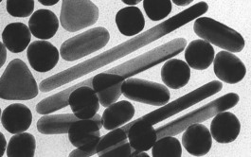
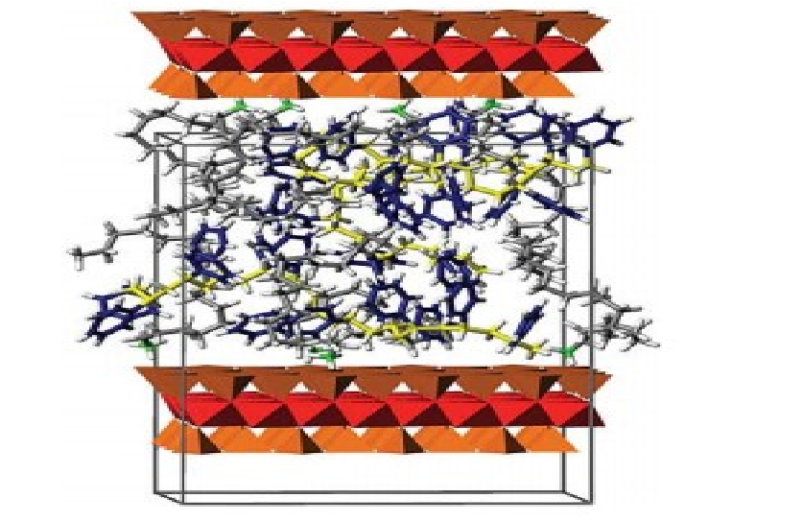
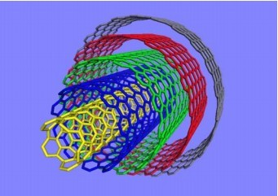
Key Nano Technologies
• NANOPARTICLES
• NANOCOMPOSITES
• NANOCAPSULES
• NANOPOROUS MATERIALS
• NANOFIBRES
• CARBON NANOTUBES NANOCOATINGS

Slide 4
Waterproofing With Nanotechnology
Swiss chemists have developed a water proof nano-fabric that does not get wet. Researchers from the University of Zurich made this fabric from polyester fibres that are coated with minute silicone filaments. They also claimed that this fabric is the most water-repellent clothing material available till date.
The principle behind the fabric’s water resistance is that the 40-nm wide silicone nanofilaments are extremely hydrophobic in nature. Moreover, their spiky structure enhances this surface chemistry and forms a protective coating on the fabric to prevent water droplets from entering or soaking the cloth. The coating’s nanostructure and the hydrophobic property together produce this super-hydrophobic effect in the fabric.

Slide 5
Types Of Nano Particles
Microbe-killing silver
Silver nanoparticles are added to clothing for their powerful ability to kill bacteria and fungi, and to prevent the nasty odors they cause. Nano silver particles release positively charged ions that stop bacterial cells functioning. The particles' tiny size means the garment stays soft and wearable.
Silica for waterproofing and stain resistance
Nanoparticles of silica incorporated into the weave of a fabric or sprayed onto its surface create a coating that repels water and stain-producing liquids. The angle and roughness of the silica coating creates enough surface tension to ensure that liquids form beads that roll off the fabric rather than soaking into it.
Sun blocking titanium dioxide and zinc oxide
Ever got sunburnt through your T-shirt? Nanoparticles of titanium dioxide or zinc oxide are incorporated into textiles to protect your garments – and your skin – from sun damage. Both particles scatter the ultraviolet light in sunlight, and do so more effectively as nanoparticles rather than as larger particles.
Antistatic particles
Some fabrics – particularly synthetics such as polyester and nylon – tend to gather static charge. Whisk a top over your head and your hair stands on end. But nanoparticles that conduct electricity, such as zinc oxide, titanium dioxide and antimony-doped tin oxide, can help disperse this charge.

Slide 6
Current Nanotechnology Applications
Nano whiskers : that cause water to bead up, making the fabric water and stain resistant.
Silver nano particles : in fabric that kills bacteria making clothing odor- resistant.
Nano pores : providing superior insulation for shoe inserts in cold weather.
Nao particles : that provide a "lotus plant" effect for fabric used awnings and other material left out in the weather, causing dirt to rinse off in the rain.
Nano Care
Nano Pal
Nano Dry
Nano Touch

Slide 7
Production Techniques
Metal sputtering technology and metallic nanoparticles
Cold plasma technology
Colloidal solutions
Sol-gel synthesis
Electrospinning

Slide 8
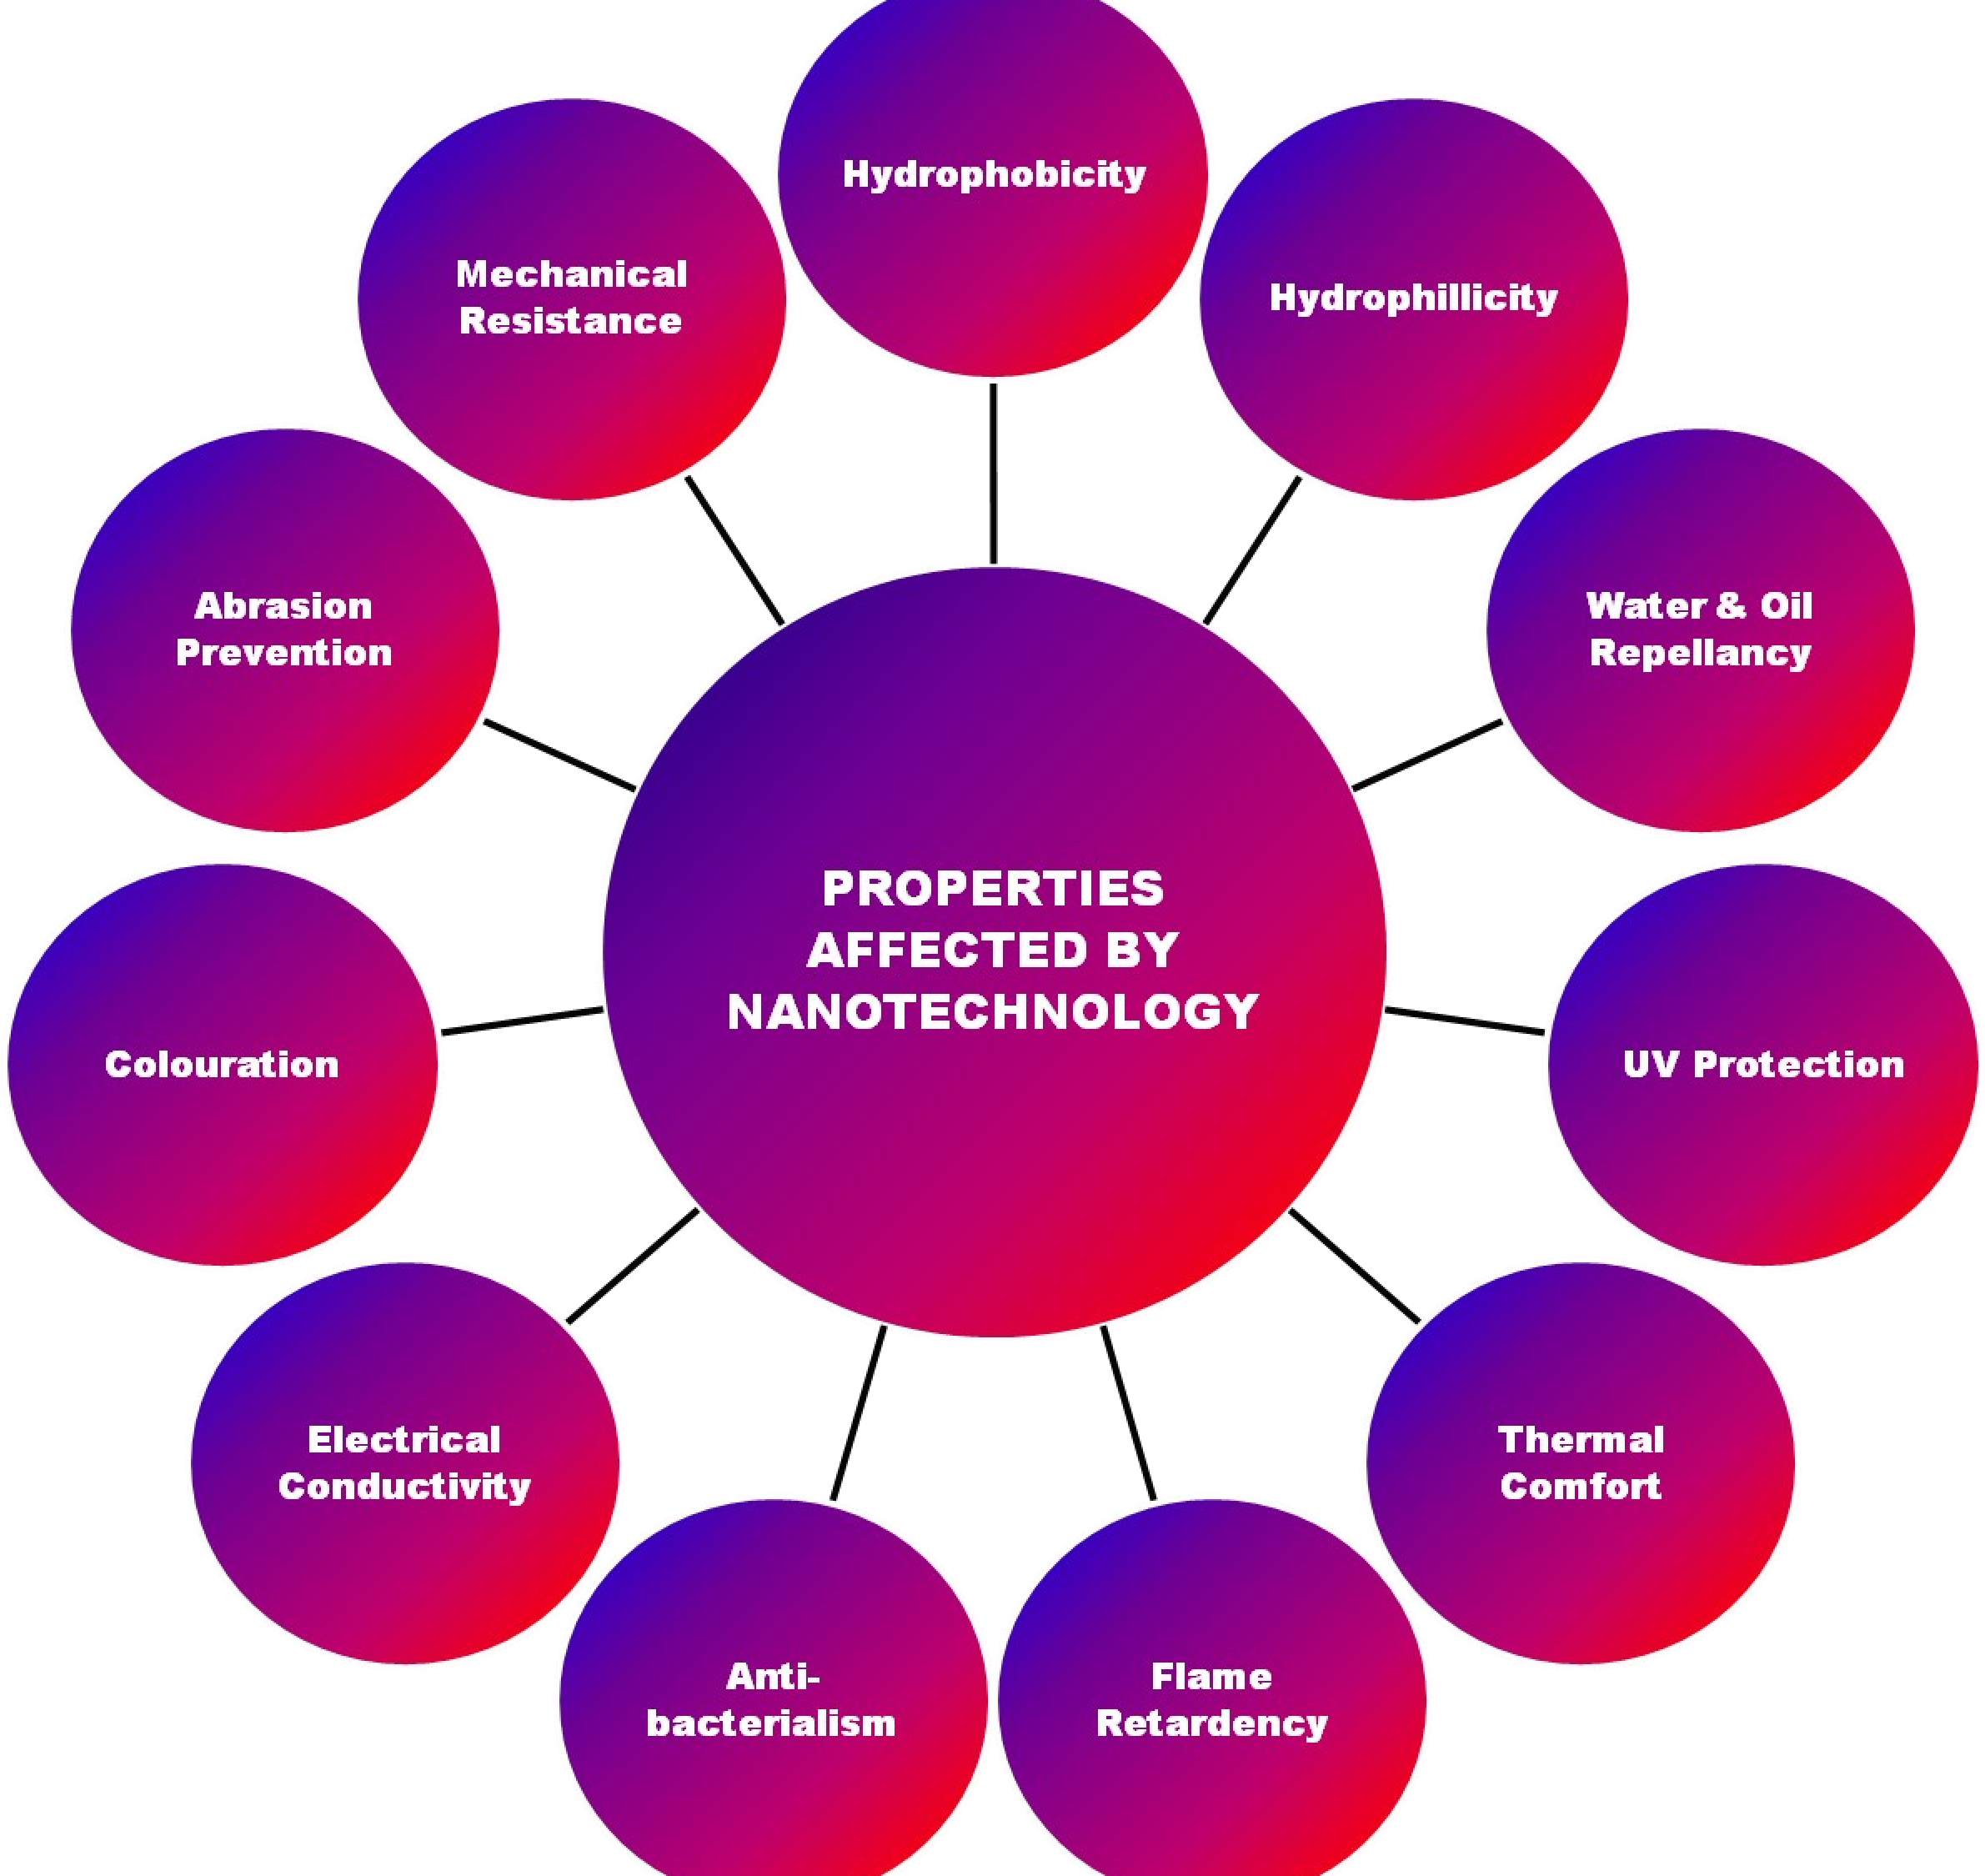
Properties
Properties of substances dramatically changes when their size is
reduced to nano meter

Slide 9
Climate Control
An MIT student has come up with an interesting nanotech idea of turning clothes into personal climate control systems. A line of shoes, jackets, and helmets called Clima Ware developed by him can act as personal ACs or heaters at the press of a button.
The jackets can cool down to 17°C (64°F) and heat up to about 40°C (104°F), and can run for over 8 hours on just one set of batteries. These jackets can work in all weather conditions where the temperature is between -30 and 50°C (-22 and 122°F). So except for polar regions, where the temperature often falls below -40°C (-40°F), it can be used in almost any place on earth!
The principle behind this technology is the Peltier Effect. When electricity is passed through two connected metals, one will cool and the other gets heated up. The jackets have puck-like inserts designed to touch spots that are dense in blood vessels and where little sweating occurs. These spots are best for the control of body temperature.
Clima Ware may not be the first of its kind, but these products are characterized by their light weight, which makes them find applications in defense, health care, athletics, and other personal climate control uses. Currently, this innovative product team is working with the military in an attempt to develop a mechanism for heating/cooling in missiles.

Slide 10
Improving Nanotechnology Fibric.
Making composite fabric with nano-sized particles or fibers allows improvement of fabric properties without a significant increase in weight, thickness, or stiffness as might have been the case with previously-used techniques. For example incorporating nano-whiskers into fabric used to make pants produces a lightweight water and stain repellent material.
The coating traps a fine layer of air in the fabric and help in keeping water at bay. This layer is known as plastron and can reduce drag when inside water, which paves the way for interesting applications in swimsuits and athletic swimwear. Interestingly, this whole idea has been inspired by naturally water-repellant surfaces such as lotus leaves, which have a similar combination of tiny nanostructures and hydrophobic substances.
As of now, the coating is most effective on polyester, though it can be tried on wool and cotton too. The coating is made using a single-step process involving the condensation of gaseous silicone into fibres giving rise to nanofilaments. The coating has also been found to be durable compared to other hydrophobic coatings.
There are some environmental concerns, as ever, with nanomaterials being included in consumer products, where their disposal route is uncertain, and contamination of waste water is a potentially huge issue. Not all nanomaterials are as dangerous as silver, however, and further research will only enhance our understanding of how to prevent pollution issues and make nanotechnology safer.

Slide 11
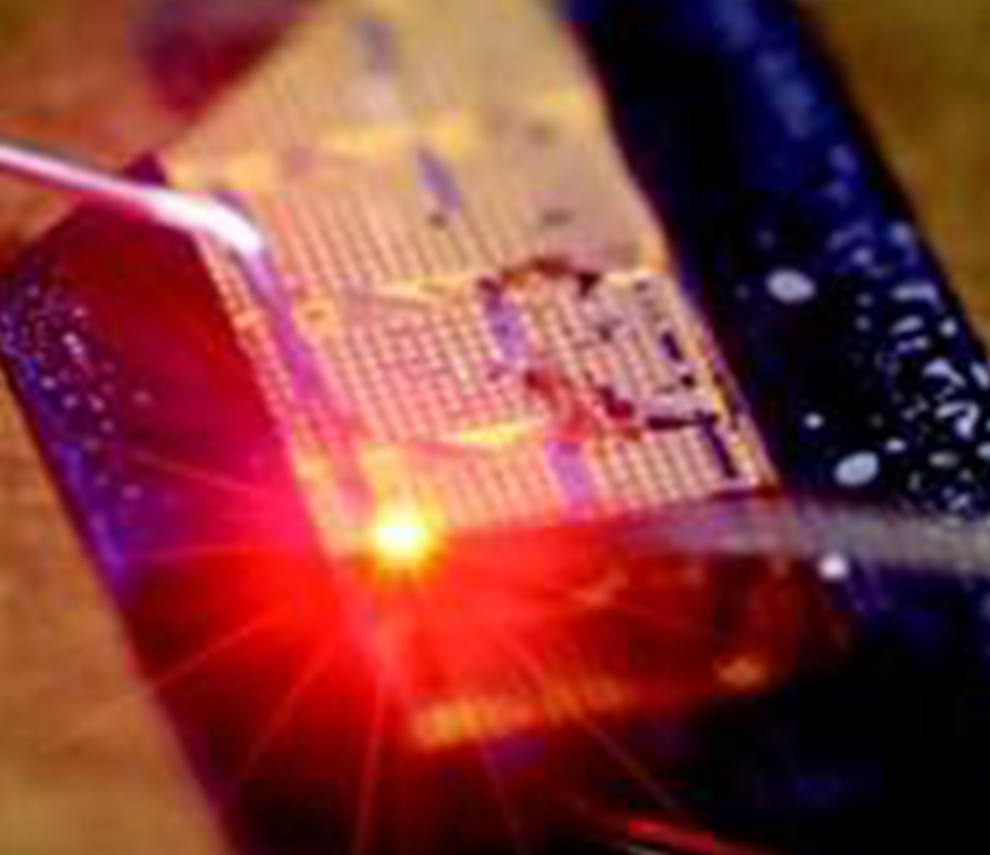

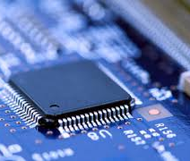
THANK YOU!!!

